Slide 1
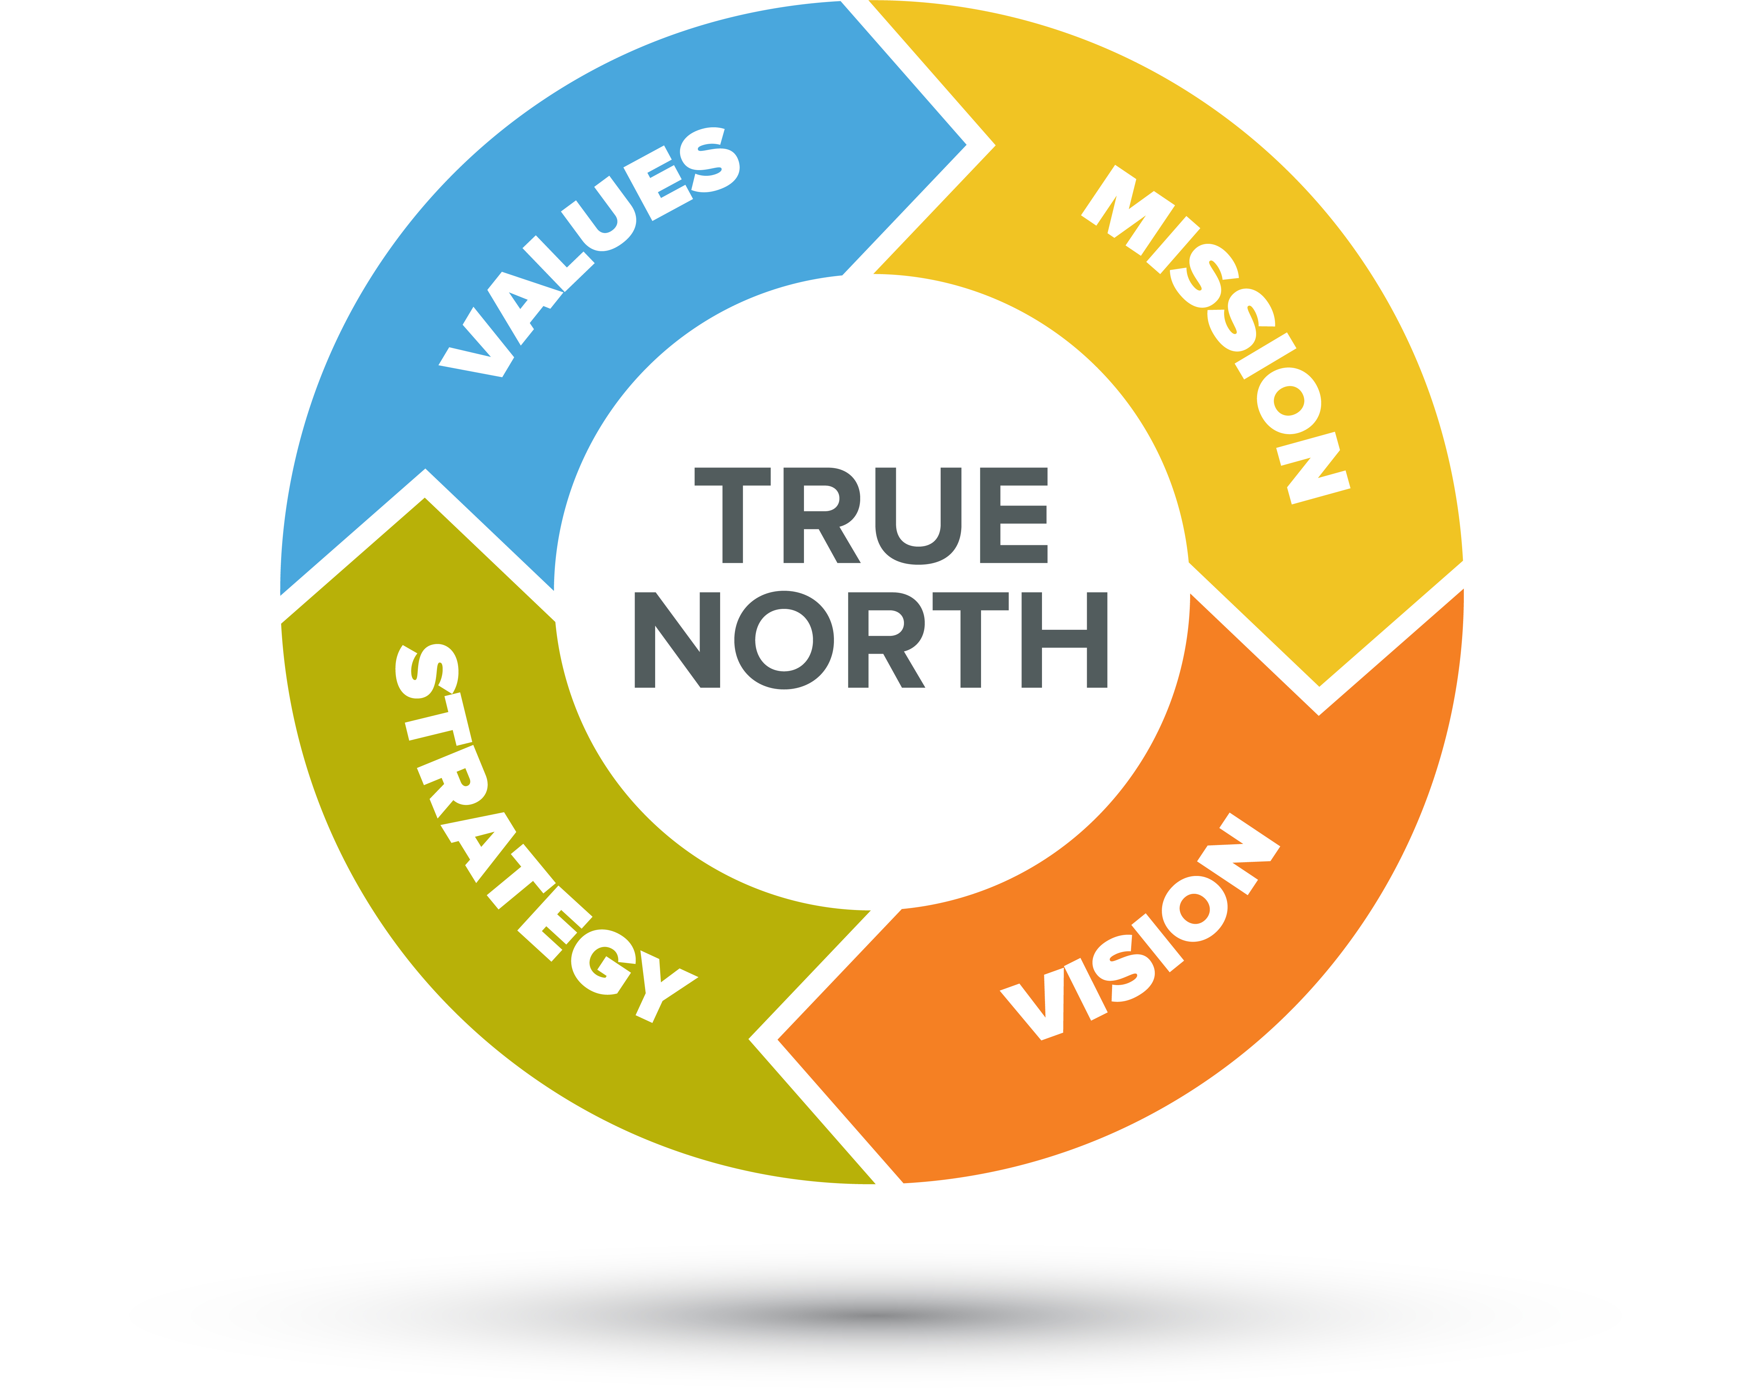
Our Mission
What is our Mission?
Why do we exist? What do we do better than others?
Who is our beneficiary? This is typically not “inside” the church. Who can we reach or serve better then others in our local community?
What is our objective or desired result? What difference would we like to see in 5 or 10 years?
State the mission. This could be a series of short phrases
Does it help us say no to good things? Help making the “hard” decision on how our resources will be used (volunteers, dollars, time, etc.)
TASK:
Develop our mission, keeping in mind the core values we identified in the last session.
Notes:
Steps:
Review Slide
Read Good Mission examples:
Starbucks: To inspire and nurture the human spirit – one person, one cup and one neighborhood at a time
Amazon: To be Earth’s most customer-centric company where people can find and discover anything they want to buy online.
Walmart: We help people save money so they can live better.
Review the Preliminary Core Value Summary list:
Welcoming, Community Service/generosity, Freely Accepting, Youth Support, Spiritual Accessibility/Variety, Openness, Willingness to change/evolve
Have group develop several mission phrases. Do not need to get to one only. Discussion how the points on the slide relate to each phase. What is missing?
TIPS:
Stay Neutral and Positive. Don’t Influence!
Encourage Participation:
“Tony, do you have any thought on this?”
“Mary, how do you feel about what has been said so far?”
Listen and ask clarifying questions:
“Tony, could you explain that a bit more?”
“Mary, did I document your idea as you expressed?”
Watch your time! Set a 10/10/5 minute warnings on your phone
Document all ideas and star the top 3-4

